Slide 1


F&O Integration Roundup

Slide 2
In this session, we'll discuss each available integration technology, a high-level overview of how to use Dynamics 365 F&O along with the pros and cons for each approach, how to select a technology for an integration, and how that technology is best used
PowerPoint available for download at https://github.com/NathanClouseAX/CommunityPresentations/tree/master/2024

Slide 3

Nathan Clouse
Technical Architect, enVista
Microsoft Business Applications MVP
www.atomicax.com
www.dynamics.fo
NathanClouseAX on LinkedIn, Twitter, few others

Slide 4

Integration Options Available
2021
DMF: Data Migration Framework
OData
Excel Add-In
Custom Services
Dual Write
Recurring Integrations
Data Management REST API
Power BI
Business Events
Power Platform
Power Automate
External Services
Entity Store
Bring Your Own Database (BYOD)
Azure Data Lake
Azure Synapse Link
All the Azure Tools

Slide 5

Integration Options Available
2024
DMF: Data Migration Framework
OData
Excel Add-In
Data Management REST API
Manual
Forms & People
Journals
Technical
Custom Services
XML
JSON
Azure Tooling*
Power Platform*
Data Entities
Extensions
External Services
X++ / C#
Dual Write
Reporting
Power BI
Entity Store
Azure Tooling
Business Events
Data Events
Logic Apps
Function Apps
Power Platform
Power Automate
Power Apps
Data Availability
Bring Your Own Database (BYOD)
Azure Data Lake
Azure Synapse Link
Other Stuff
Azure Data Factory
Third party ETL Tools
Recurring Integrations

Slide 6
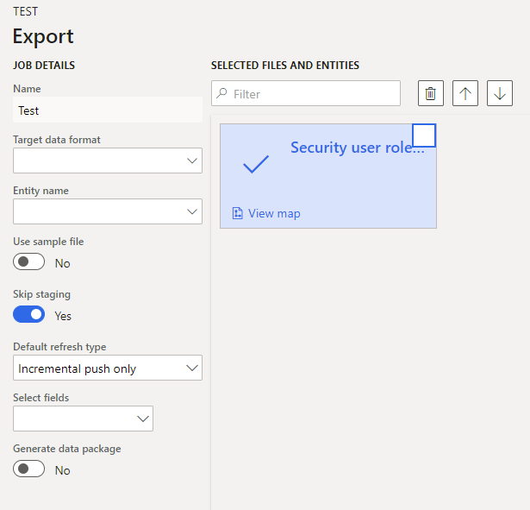
DMF – Data Migration Framework
Core of lots of integration tech
Interactive in F&O way to import and export data
Works for small or large files
Works with multiple formats
CSV, Excel, XML, No JSON, Parquet, other big data formats
Can be incremental for data import or export
Use artifacts called data entities
Data entities are a collection of tables that represent a concept in business

Slide 7
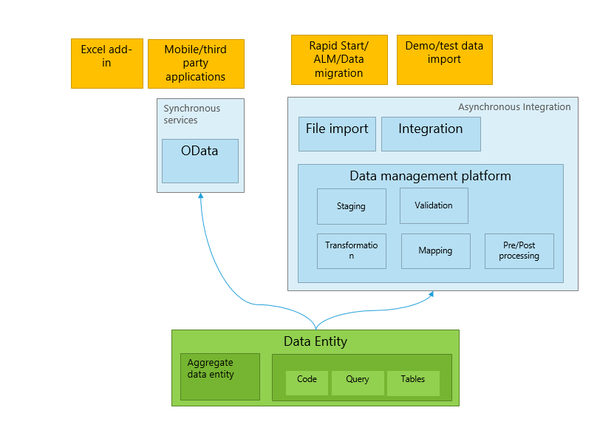

Slide 8
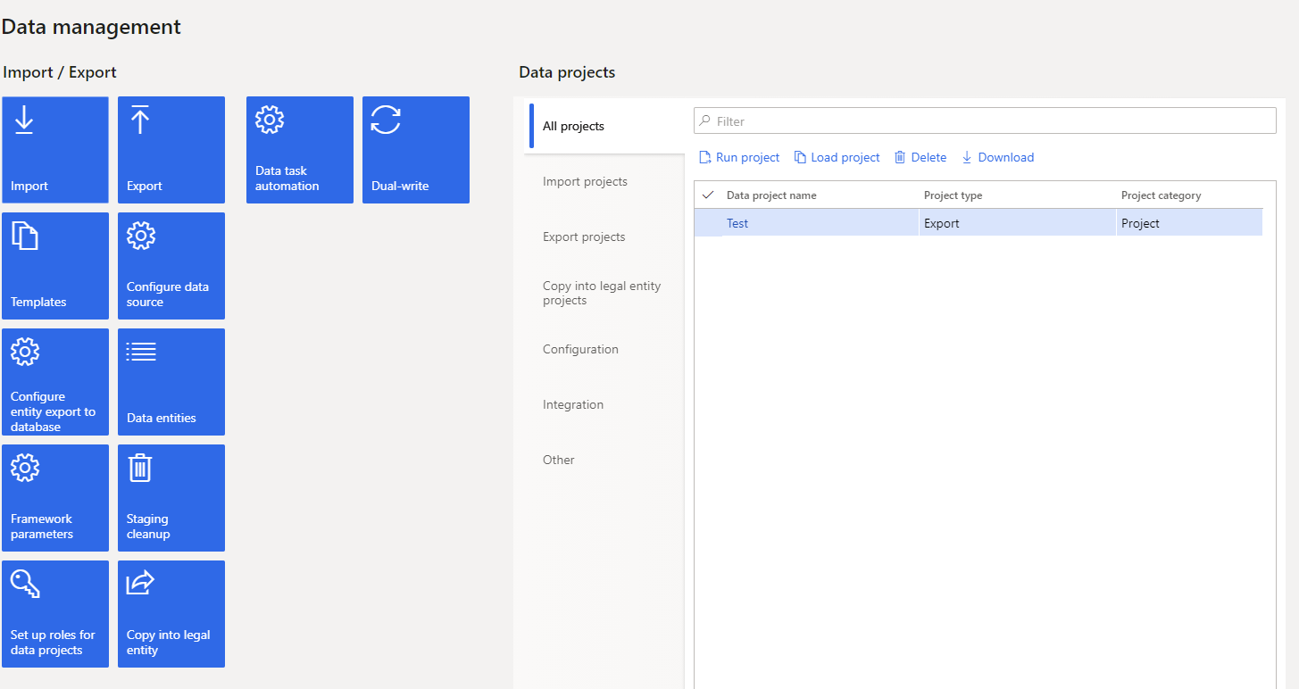
DMF – Data Migration Framework
Dedicated workspace in System Administration
Create data projects for scenario you are working through
UI can be a bit clunky
Collections of data entities called Data Packages

Slide 9
DMF Shootout
The Good
The Bad
Suitable for large data integrations
Incremental data import/export possibility
Staging tables for data validation
Can be used in lots of interactive/different scenarios
No support for modern big data formats
UI is not user friendly and confusing
Table lock problems, parallel executions will fail for the same data entity although async import like this is possible
Performance can be disappointing

Slide 10

What’s DMF Good For?
Interactive data import
Interactive data exports
Data migration

Slide 11
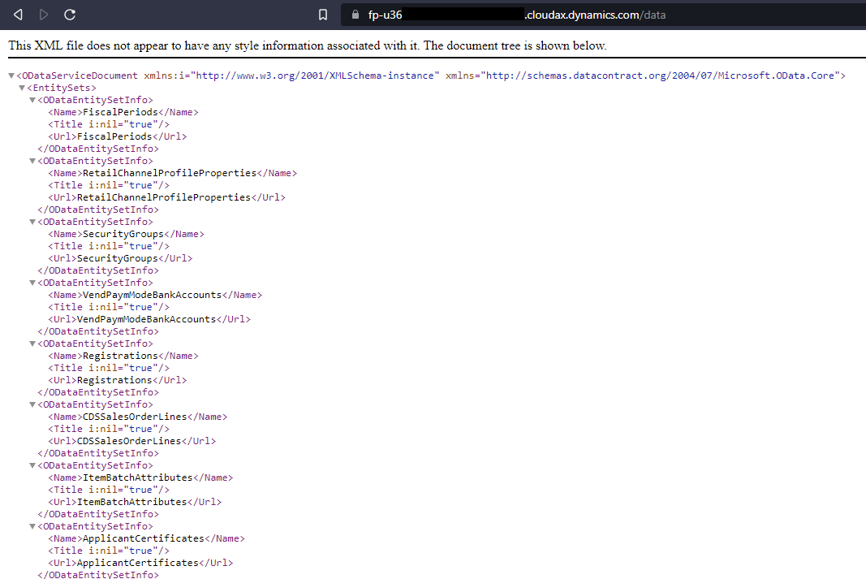
OData
Data entities from the DMF can be exposed to a REST endpoint with AAD OAuth.
Entities in the AOT that are set to public are also OData entities.
Quick, easy, sometimes codeless integration
Support for basic CRUD operations for thousands of entities OOTB

Slide 12
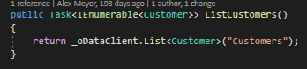
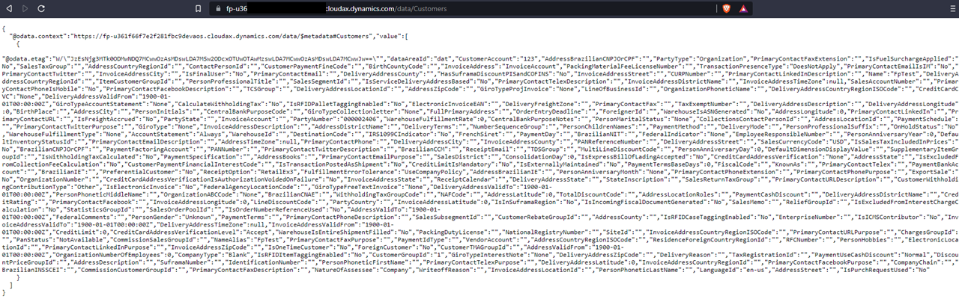
OData
Can use OData actions; basically, methods to execute some logic
Can be used for more complex integration scenarios
Data entities can be complex and support multiple scenarios
Can be throttled

Slide 13
OData Shootout
The Good
The Bad
Easy to use / consume
Lots of OOTB Data entities that support CRUD operations
Plugs into other platforms easily
Custom Actions / methods
Slow queries sometimes
Slow CRUD operations sometimes
Postings generally not supported
Throttling can occur

Slide 14

What’s oData Good Far?
Low volume requests for data
Power Apps
Simple interactions

Slide 15
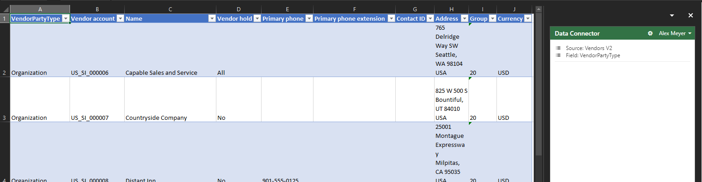
Excel Add-In
It’s Excel
Very similar to OData because it is OData.
Could be a replacement for other upload tools that are Excel based
Export list pages out of F&O, make changes, upload the changes

Slide 16
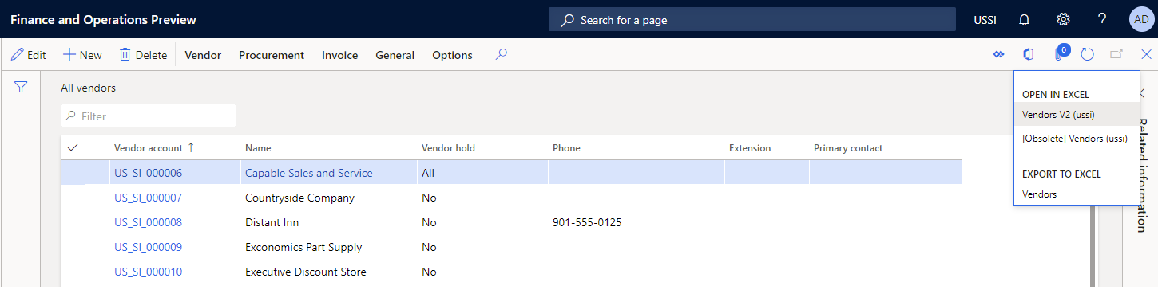
Excel Add-In
Not subject to throttling or resource management
Not all entities work well with Excel
“List Management”

Slide 17
Excel Add-In Shoot Out
The Good
The Bad
Easy to Use
No additional setup – just enable the add on in Excel when prompted
Can be used by anyone that knows Excel
Slow
Sometimes quirky

Slide 18

What is Excel Add-in Good For?
Bulk operations
Anything Excel can do

Slide 19
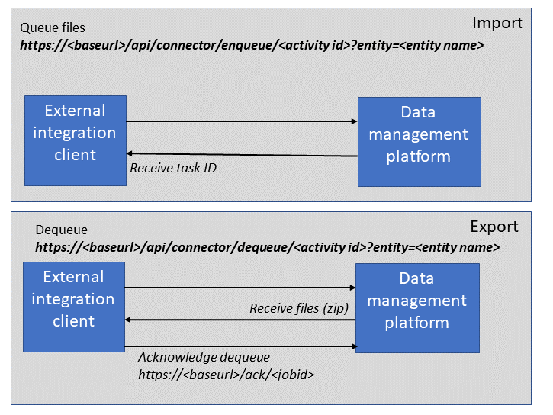
Data Management REST API
DMF but via an API
Programmatic way of interactive with the DMF
Only data packages are supported for import and export
Largely like DMF otherwise

Slide 20
Data Management REST API Shootout
The Good
The Bad
Same as DMF
Can be used to get large quantities of data in and out without relying on a UI
Same as DMF
Table lock problems
Parallel executions will fail for the same data entity although async import is possible

Slide 21

What is DMF Rest API Good For?
programmatic data import
programmatic data exports
Programmatic data migration

Slide 22
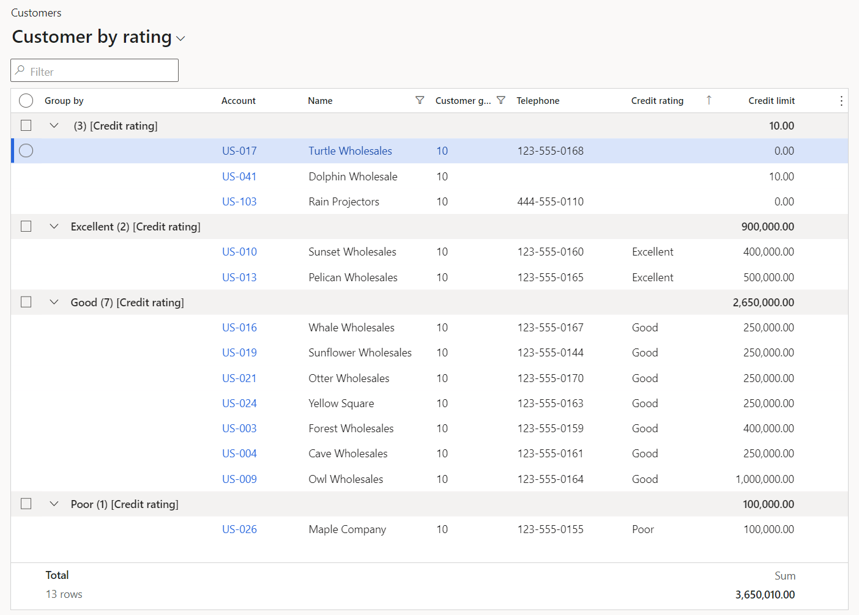
Forms and People
Can type small stuff in by hand
Can paste stuff into grids
Bulk Edit in Grids
Show Calculated Fields
Math Expressions
Grouping

Slide 23
Forms and People
The Good
The Bad
Grid Control is very powerful
Lots of utility value
Sometimes a little clunky and slow

Slide 24

Journals
Keep it simple
Paste stuff in from the outside
Make templates for journals
Configure the system to proposal recurring items

Slide 25

Journals
The Good
The Bad
Automate the simple stuff
Have to know its there

Slide 26

Custom Services
Powerful and flexible
Support CRUD operations as well as posting of transactions
X++ based, you build to suit
Replacement for AIF services from older versions
XML and JSON formats with AAD OAuth

Slide 27
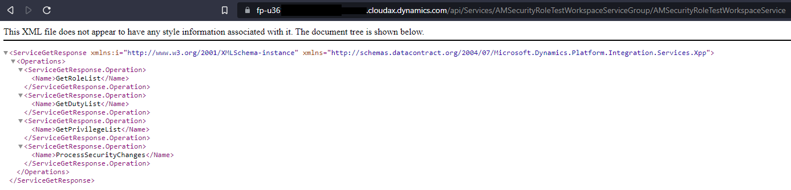
Custom Services
Uses contract which are converted to JSON or XML
No endpoint management tools like in older versions
Could support large data loads*

Slide 28
Custom Services Shoot Out
The Good
The Bad
Flexible and customizable
High performance*
Support CRUD and postings
JSON and XML endpoints automagically
Could use Azure API Manager
May not work with large* data transfers
X++ based
Requires experienced developer
No management or monitoring in F&O
May have to use Azure API Manager

Slide 29

What are Custom Services Good for?
Integrations - Postings
Complex Operations
Interactions that have to be (relatively) fast
Anything where you have to build it yourself

Slide 30
Data Entities
Represents a concept rather than a table
Performs a specific task or set of tasks
4,533 entities as of 1/10/2024
Composite entities too!
Sometimes fickle

Slide 31
Data Entities
The Good
The Bad
Easy to Use
Easy to Extend
Tons of utility value
Multiple versions of entities available for different scenarios
Sometimes slow
Generally not set-based*

Slide 32

What are Data Entities good for?
Create, Read, Update, Delete type workloads (CRUD)

Slide 33
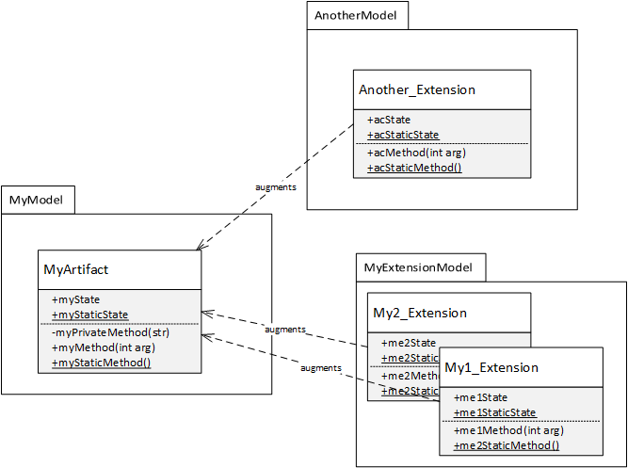
Extensions
CoC – Change of Command
EH – Event Handlers
Add fields to tables, data entities, forms, UI, reports, etc.
“Do What You Want” *
Augment
Not Replace

Slide 34
Extensions
The Good
The Bad
Can build whatever you need
Hook into OOTB processes to add your “special sauce”
Programming (general)
“final”
“private”

Slide 35

What are Extension good for?
“Filling in the blanks”
Adding whatever your organization's processes need that isn’t out of the box

Slide 36
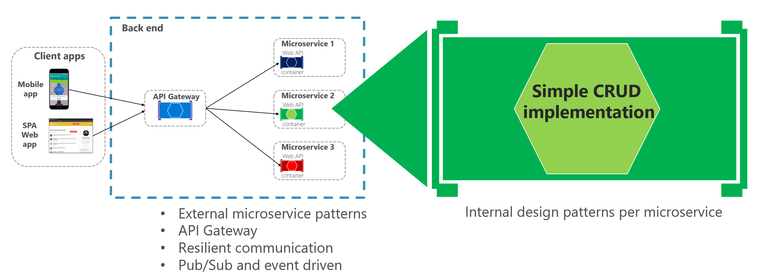
External Services (3rd Party outside F&O)
Consume outside APIs using X++ and .NET
Add .NET for specific API (wrapper, library, etc.)
Async and sync APIs are support with different design patterns
Similar to AIF related options in 2012 but with .NET

Slide 37
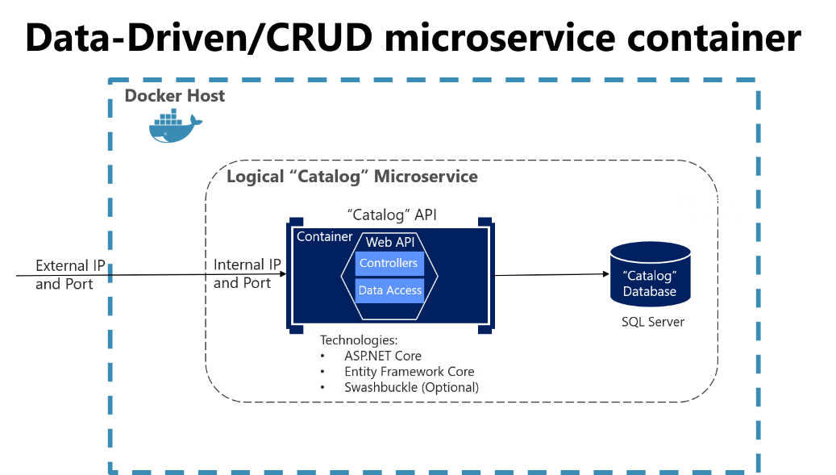
External Services (3rd Party outside F&O)
Create .NET project
Create x++ project
Call .NET binary in x++
Process the (final) result

Slide 38
External Services Shoot Out
The Good
The Bad
Generally high performance
Interacting directly with outside data source with no middleware
Flexible; build what you need how you need it
X++ development plus .NET development
Interacting directly with outside data source with no middleware

Slide 39

What are External Services good for?
Specialized workloads to supplement or support F&O

Slide 40

X++ / C#
X++ is a powerful business programming language
C# is a powerful programming language
X++ is good with time, money, and databases
C# is good with everything else

Slide 41
X++ / C#
The Good
The Bad
Fast
Highly scalable
X++ Built for purpose
C# has lots of utility value
X++ is specialized
C# in F&O is an older version

Slide 42

What are X++ and C# good for?
2 languages available to solve problems
Complement each other

Slide 43
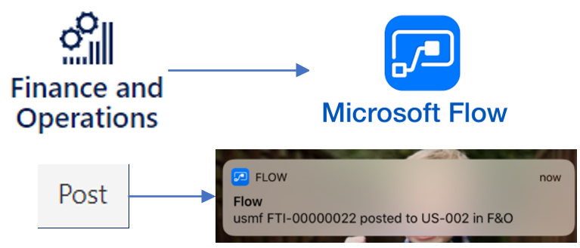
Business Events
Send out that something happened
Catalog of available events but you can build your own also
Lots of different endpoints available in Azure and HTTPS recipients
Lightweight messaging framework

Slide 44
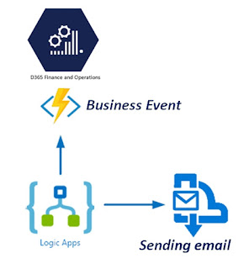
Business Events
Can be used to send a simple notification, start or update a workflow in Power Automate, send a message to a queue or event grid in Azure
Simple, Lightweight
(near) Real-time emission of events
Suggest using batch job

Slide 45
Business Events Shoot Out
The Good
The Bad
(near) real time emission of events from F&O for outside actors to respond to
Subscription to events automagical with Power Automate or Logic Apps
Create custom events if what you want isn’t already in calendar
Messages should be tiny, only contain what you need
Not a data transmission framework
Custom events required X++ development

Slide 46

What are Business Events Good For?
Events based on a Posting that are lightweight
High performance

Slide 47

Data Events
Like Business Events but more
Whole record is sent
Can be configured for Create, Update, or Delete (CUD)
Based On Data Entities

Slide 48

Data Events
The Good
The Bad
Easy to setup
Easy to consume
Lots of utility value
Can be slow
Can be “too much”

Slide 49

What are Data Events Good For?
Events based on Creates, Updates, and Deletes of records
Some postings, but not all

Slide 50
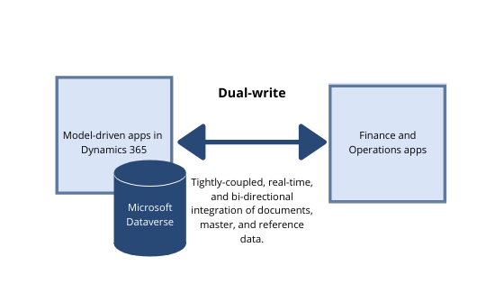
Dual Write
“Couple” data in F&O to Dataverse (formerly CDS)
Push/pull data from Dataverse to F&O
Near real time, “tightly coupled” data entities
Currently Async but someday will be sync
Can be running or paused

Slide 51
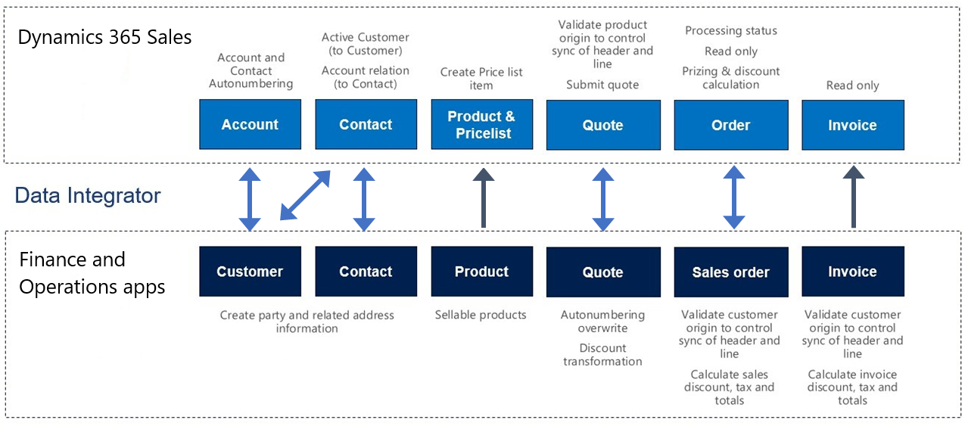
Dual Write
Near Real-Time
Setup in F&O, do an initial sync then start real-time sync mode
Not all data entities are available
Some data in different structures between D365 apps

Slide 52
Dual Write Shoot Out
The Good
The Bad
Near real-time integration with Power Platform / Dataverse
Paused and running modes with cached writes in paused mode
Queries and filters for data
Can create custom data entities and maps in F&O plus Dataverse
Async, near* real-time*
Not all data models are supported
Still being invested in and changing

Slide 53

What is Dual Write Good For?
When Sales activity should be in F&O*
When F&O activity should be in CE/CRM*

Slide 54
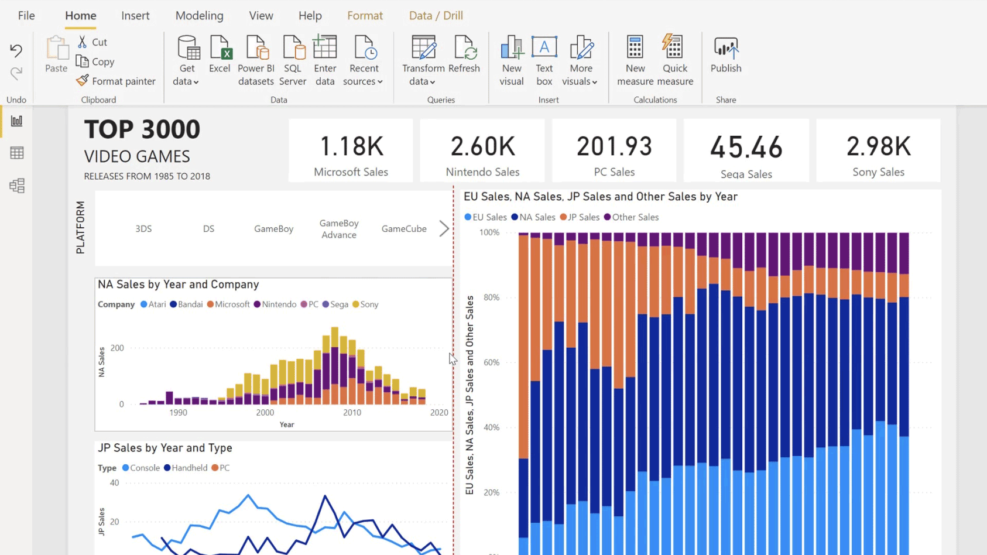
Power BI
PowerBI.com integration comes with F&O
Power BI desktop may be additional (depends on licensing)

Slide 55

Power BI Shootout
The Good
The Bad
If customization required, can be connected to Data Entity or Service Operation endpoint
As Is or Build your own

Slide 56

What is Power BI Good for?
In the context of embedded Power BI in F&O, simple stuff
General, everything BI

Slide 57
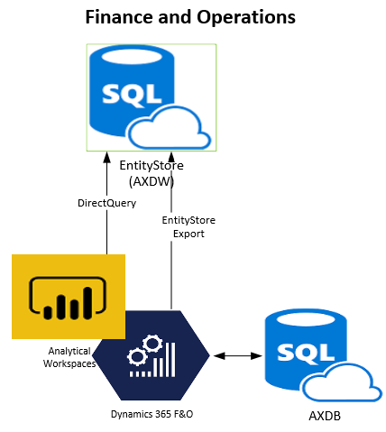
Entity Store
Database optimized for reporting that is included with F&O
Uses in-memory, clustered columstore index (CCI) on SQL Server
Star-Schema based using data entities to provide aggregate measures

Slide 58
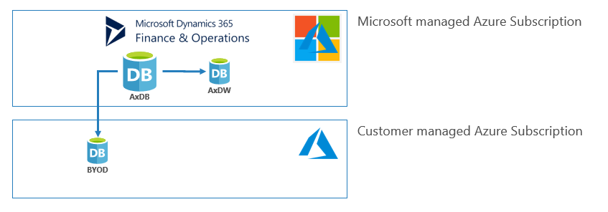
Entity Store
Can connect via PowerBI using DirectQuery
Can create reports for large data sets based on measure and reports are updated when the entity store is updated
Schedule refreshed, typically nightly
Build your own measures

Slide 59

Entity Store Shoot Out
The Good
The Bad
Fast way of providing analytical data
Batch/schedule processing
Read Only
Power BI Only

Slide 60

What is the Entity Store Good For?
Simple Dimensions and Facts
Can be extended for whatever you need
A “good start”

Slide 61
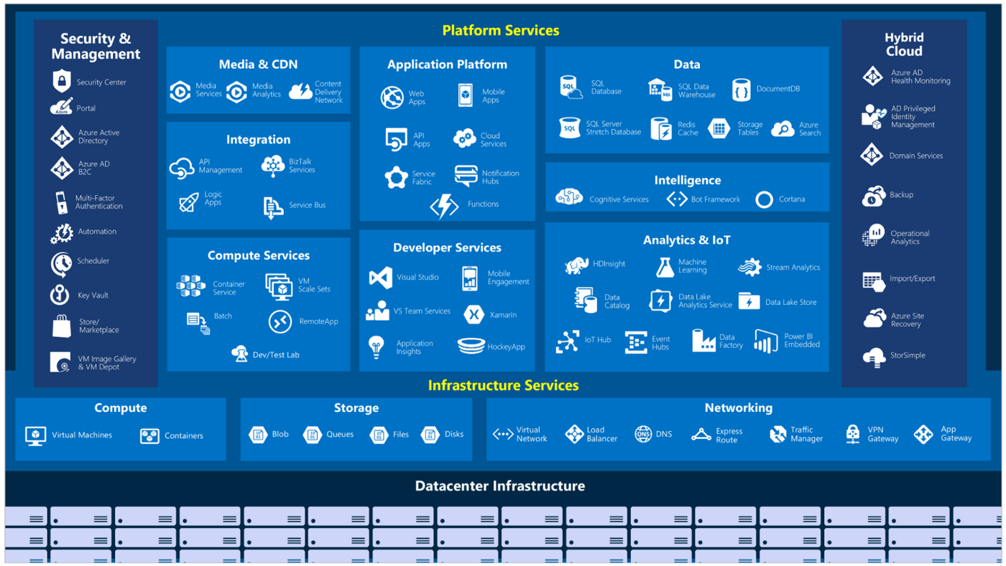
Azure Tooling
Notes:
https://satyenkumar.medium.com/demystifying-the-cloud-computing-an-overview-of-the-microsoft-azure-6a5c1fb1799d

Slide 62
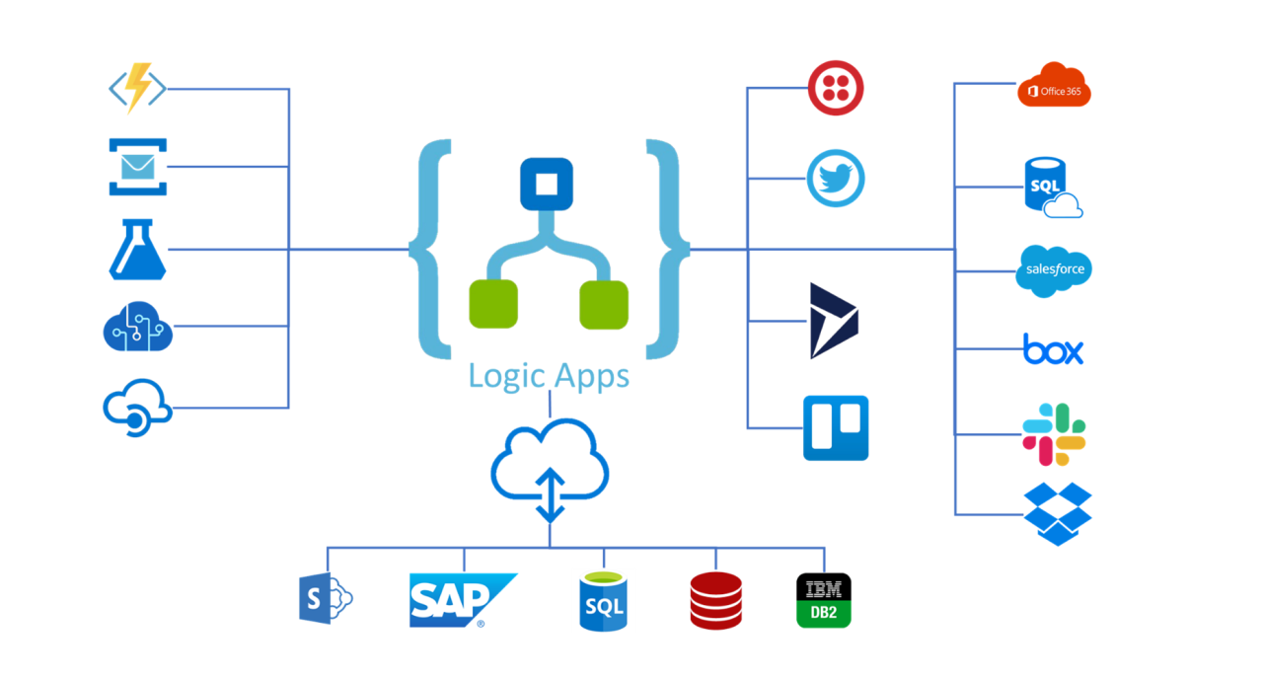
Logic Apps
Create and edit workflows
Automate processes
Connect and Integrate
Visually create a “to do” list with some intelligence

Slide 63
Logic Apps
The Good
The Bad
Easy To use
Scale pretty well
Tons of connector to talk to all sorts of things
Technical – not for beginners or power users
Some level of knowledge on basic programming constructs required
Cost

Slide 64

What are Logic Apps Good For?
Integrations
Events / Eventing
Messages
“moving stuff around”
Uncomplicated Items

Slide 65

Function Apps
C# in the cloud
Serverless execution for simple, “dumb” task execution
Event driven so it can react to various things changing around it
Also supports Java, JavaScript, PowerShell, Python and TypeScript

Slide 66
Function Apps
The Good
The Bad
Easy to develop and deploy because it’s C#
All the good things of C#
All the bad things of C#
Cost

Slide 67

What are Function Apps Good For?
Just about everything
Its C# ( or a supported language). We can tell it to do whatever we want

Slide 68
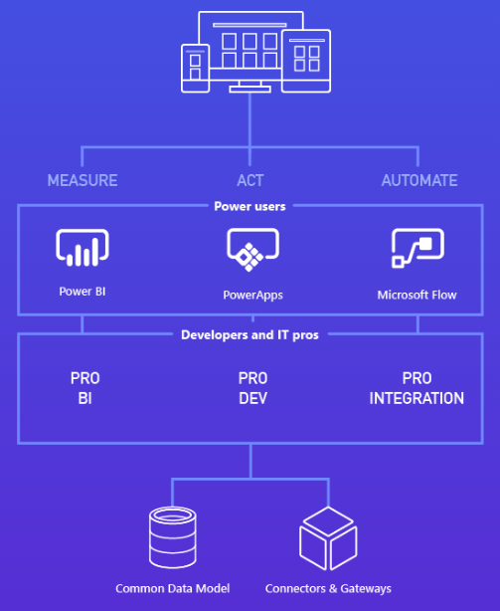
Power Platform
Using Dual-Write, you can use tools from Power Platform
Power BI and Power Automate already have specific integrations
Can use Power Apps and Copilots with F&O data
Simple, departmental UIs

Slide 69
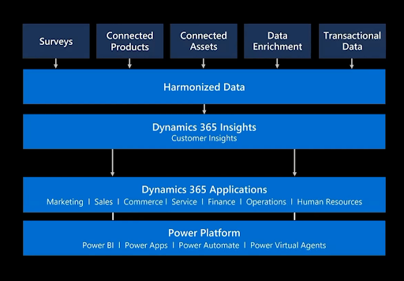
Power Platform
Solve specific business problems or scenarios using custom “low-code” Apps
Could use Virtual Agents aka “Chatbots”
Simple, fast interactions like “where’s my order” or “I’d like to return my order”

Slide 70
Power Platform Shoot Out
The Good
The Bad
Enables solving department opportunities one small problem at a time
Powerful
Complements F&O, doesn’t replace it
Advanced scenario requiring Dual-Write or Azure Data Lake
Use Appropriate Tooling

Slide 71

What is the Power Platform Good For?
“It depends”
Simple interactions or helper apps
Lists or Lookups

Slide 72
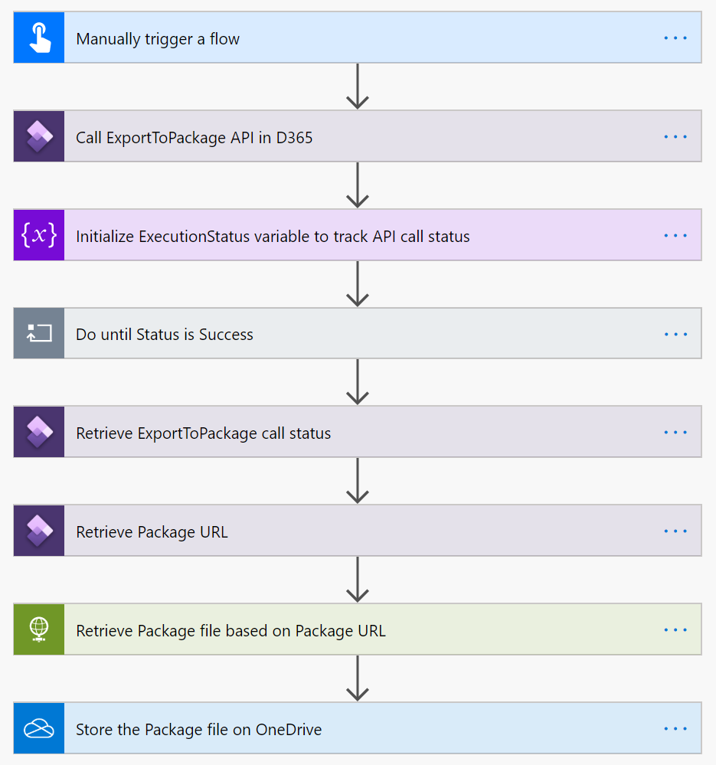
Power Automate
Can just point Power Automate at an F&O instance to get available options
If trigger is deleted or workflow is turn off, Business Event is deleted
Multiple Workflows can subscribe to different events

Slide 73
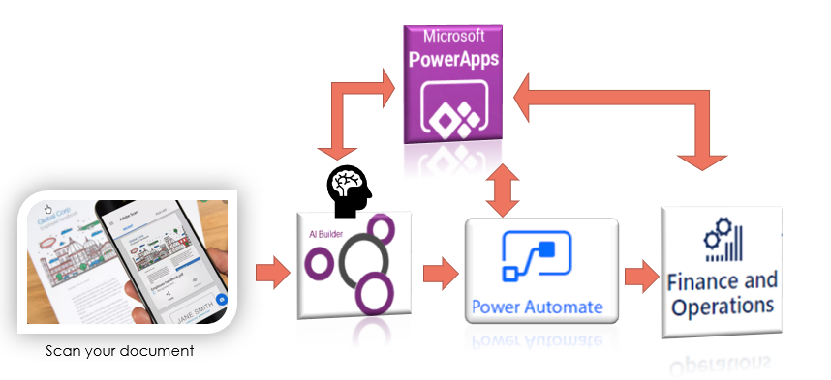
Power Automate
Works with Business Events as well as Azure Event Grid (using a connector)
All available in Power Automate
Nothing specific to F&O except knowing what environment to connect to

Slide 74
Power Automate Shoot Out
The Good
The Bad
Simple
Powerful
Supports several scenarios
All work performed in Power Automate
Limited by F&O Business Event Catalog
May require F&O Development to support Power Automate scenario

Slide 75

What’s Power Automate Good For?
“how can I automate parts of my job?”
Very similar to Logic Apps but its for (just) you

Slide 76
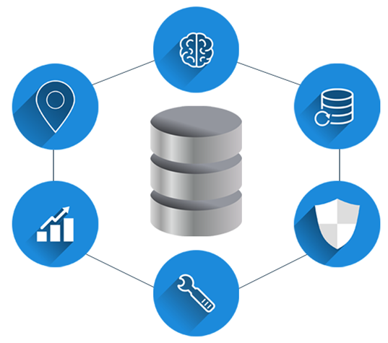
Data Availability

Slide 77
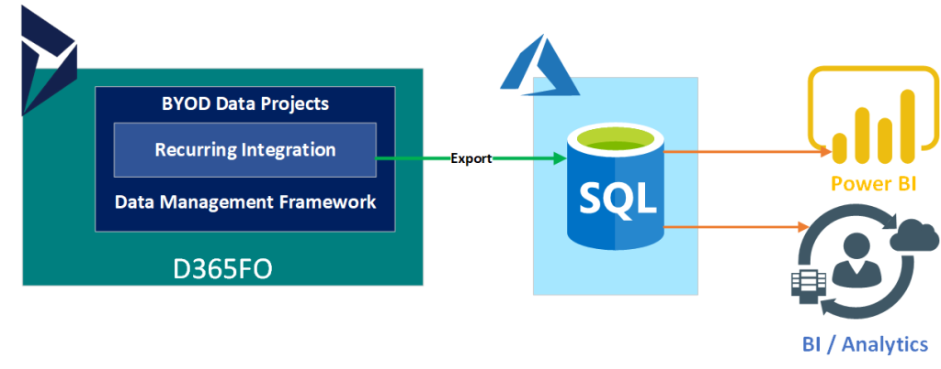
Bring Your Own Database (BYOD)
Export data entities to your own Azure SQL Instance (that you pay for)
Different from the Entity Store; BYOD is your, Entity Store is MSFT’s
Full or incremental push
More than one database
Schedule data refreshes

Slide 78
Bring Your Own Database (BYOD)
Access to data through standard SQL Connectors
Use change tracking to updates
Database can be extended to deliver specific data with new tables or views
Could be use for outbound SQL only interfaces

Slide 79
Bring Your Own Database Shoot Out
The Good
The Bad
Export Data Entities to a database you control
Can be accessed how you define it
Filtering is possible
Full or incremental pushes
Refreshes are scheduled
One way; export only
Sometimes slow
Cost and management
Future unknown

Slide 80

What’s BYOD Good for?
Getting content of data entities into external SQL

Slide 81
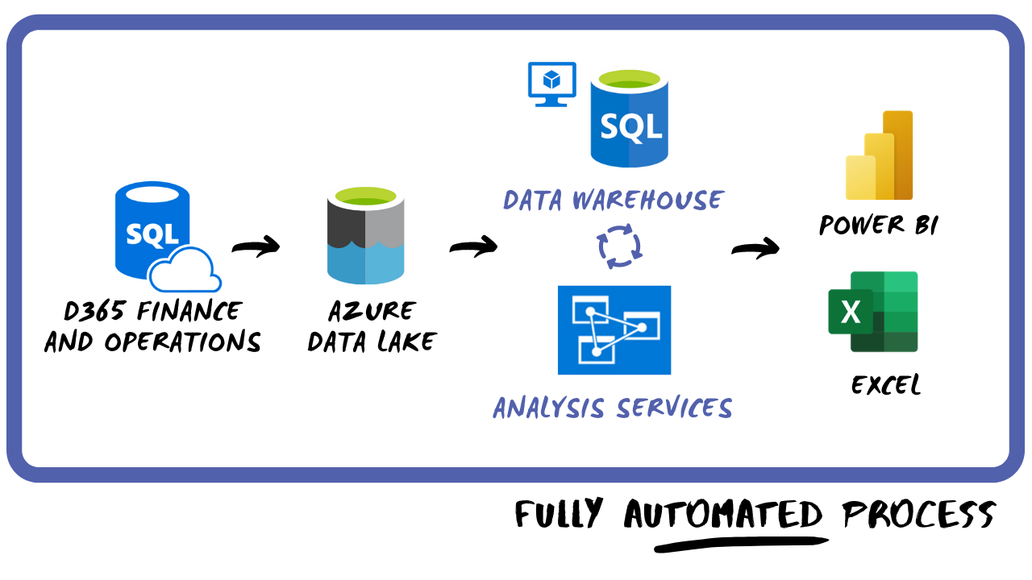
Azure Data Lake
Storage technology for Azure Data Lake Storage Gen2
Lower cost cloud storage compared to DBs
Included in customer subscription so you can bring your open data and integrate it
Allows users to build reports with their tool of choice

Slide 82
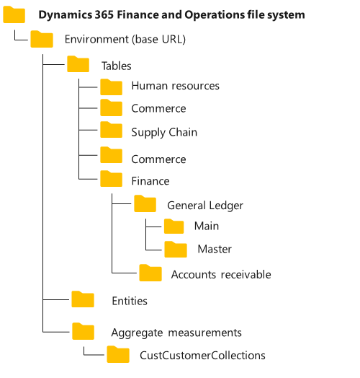
Azure Data Lake
You can select tables to be kept in sync between F&O and Data Lake (<10 minutes)
Data are stored in Common Data Model folder standard
CDM Standard means other tools can also read the data
Use data pipelines for further processing

Slide 83
Azure Data Lake Shoot Out
The Good
The Bad
Reduced storage cost compared to alternatives
Near real-time integration with automagic feeds
CDM storage standard
Can use other tools for reporting or processing of data
One way only
Advanced Scenarios require specialized skill sets

Slide 84

What is Azure Data Lake Good For?
Getting contents of tables into something that can be queried

Slide 85

Azure Synapse Link
Very similar to Export To Data Lake
Tables plus Data Entities
Continuous replicate of table and data entity data plus CUD
Defaults to Parquet
Available Now*

Slide 86
Azure Synapse Link Shootout
The Good
The Bad
Easy to configure and setup
“plug and play” for most user
Known issues: Initial export can be slow, limit of 1000 tables currently, misc perf issues
Misc setup for some options

Slide 87
What is Azure Synapse Link Good For?
Getting contents of tables into something that can be queried
Getting contents of data enties into something that can be queried

Slide 88
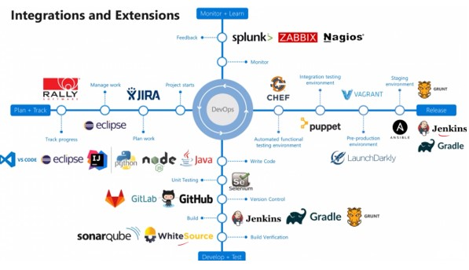
Other Stuff

Slide 89
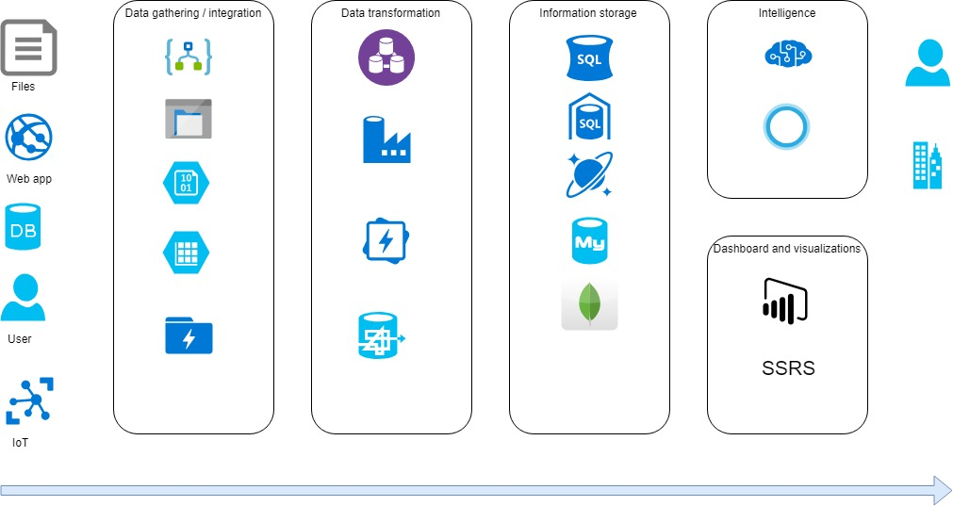
Azure Toolset
LogicApps or Functions Apps for Business Events
Azure Data Factory for Azure Data Lake
API management for OData
AI Builder plus OData
Service Bus for Business Events or messaging in general

Slide 90
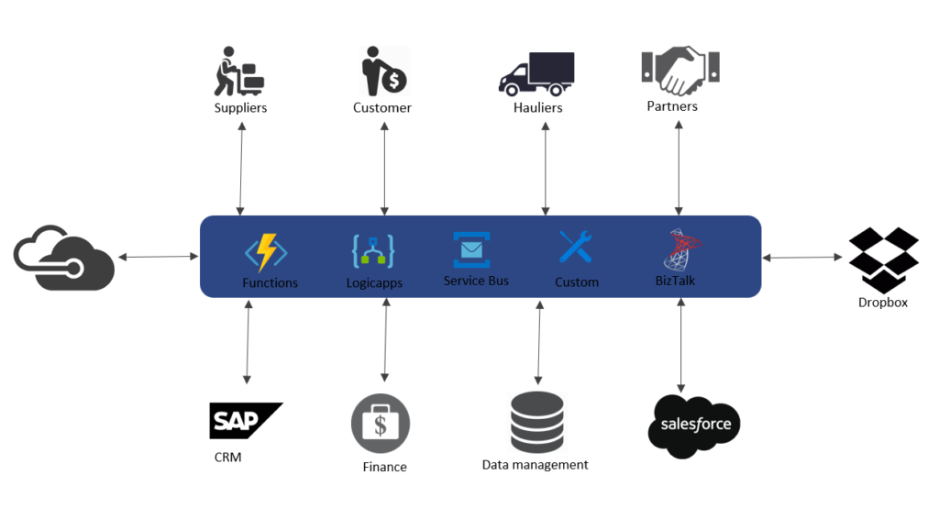
Azure Toolset
Event Grid for Business Events
Azure Functions / Function Apps for literally everything else
Log Analytics from LCS sort of
Telemetry into Analytics Workspace

Slide 91
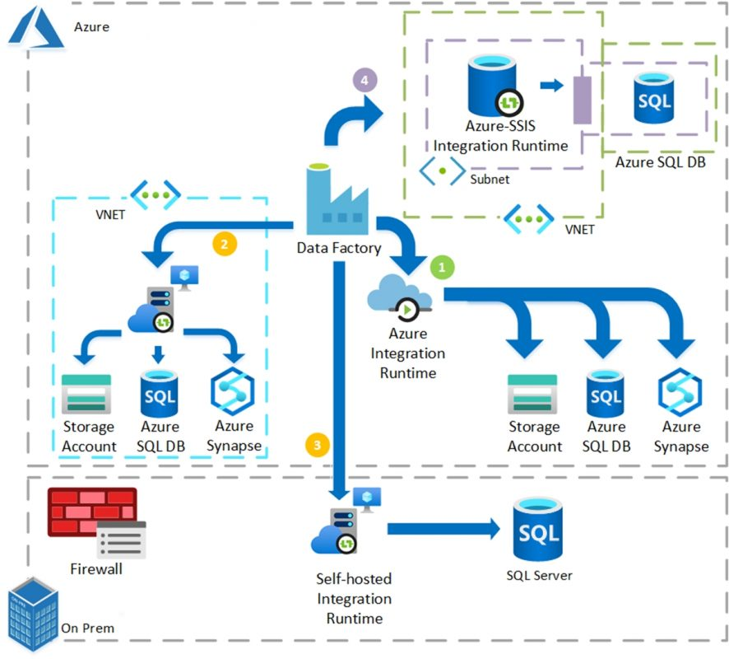
Azure Data Factory
Import, export, shape, manipulate, move, transform, consume data
Process data from F&O into something others can consume
Process data into F&O from other producers
Data Migration

Slide 92
Azure Toolset Shoot Out
The Good
The Bad
Tools available for most scenarios
Simple and Powerful
Additional specialized skillsets
Costs

Slide 93

Third Party ETL Tools
Ease of Use
Of ETL, they do one or more of those easier
Reporting
Data Processing

Slide 94
Third Party ETL Tools Shootout
The Good
The Bad
Ease of use
Utility Value
“easy button”
Cost
Cost plus

Slide 95
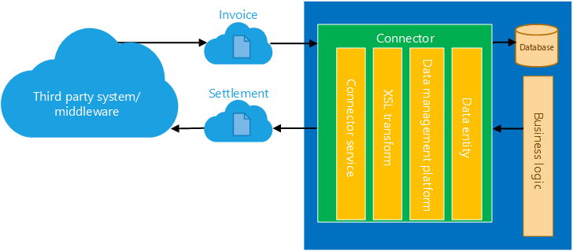
Recurring Integrations
Build on Data Entities and DMF
Enables third party apps to import data into or export data out of F&O
Standard DMF functionality; XSLT, Filters, mapping, formats, etc.

Slide 96
Recurring Integrations
DMF on a schedule
Create Data Project
Schedule Recurrence
Exchange files
Send import and monitor
Request export, monitor, get file
AAD OAuth

Slide 97
Recurring Integrations Shootout
The Good
The Bad
Feature complete integrations
Unlike Batch Data API, this supports import and export
Automated and scheduled
APIs are MSFT and not extensible
Offered “as-is” with no customization

Slide 98
What are Recurring Integrations Good For?
Large amounts of data / transactions
Stuff that can be a little slow
Things that recur
Composite Entities*

Slide 99
LCS Micro Services
The Good
The Bad
MSFT has specific integrations ready to use
Click to Deploy then use
Not extensible (generally)
Sometimes not performant

Slide 100
Questions?

